Slide 1
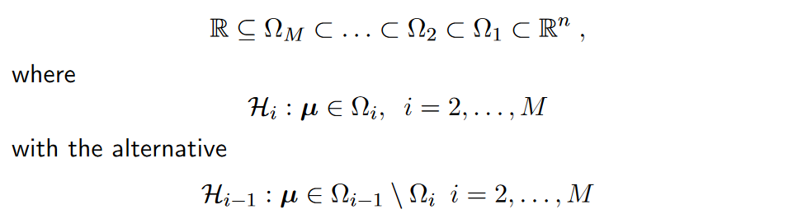
Hyp. Chain:
Type 1: Natural chain where we test down the chain
Type 3: No chain and we do partial tests.
Type 2: Type 1 between orders of interaction. Type 3 with in a order of interaction

Slide 2
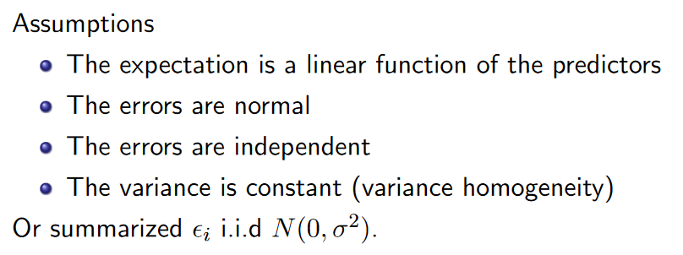
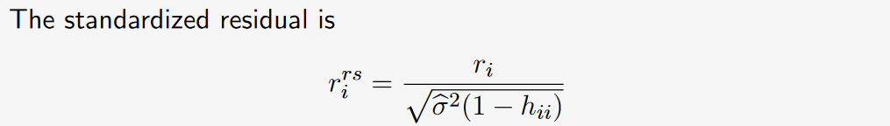
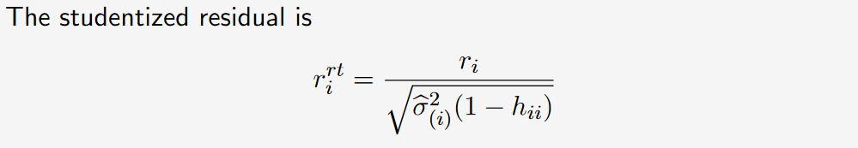
We use studentized to detect outliers because here we subtract the investigated observations own contribution.

Slide 3

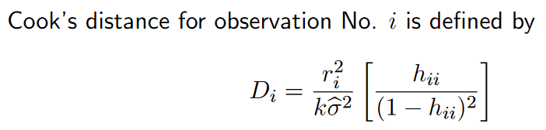

$h_{ii}$ er leverage for observation $i$.
Cooks distance kombinerer residual og leverage i et tal.

Slide 4
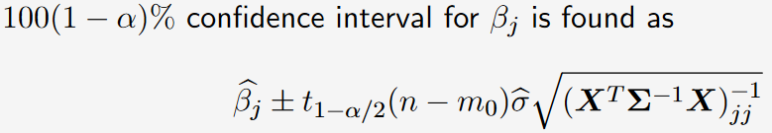
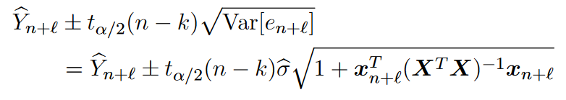
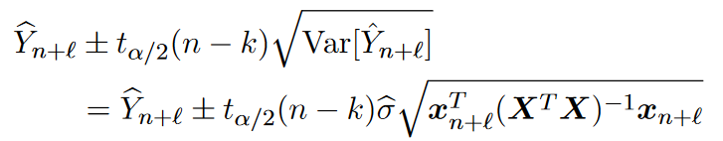
Confidence region
Pred interval
Conf interval

